Slide 1

Data Analyzing
Sean Blanchard
2/28/2021
Collecting data from HAR files to help us analyze website networking traffic. This could include number of requests per page, Percentage of URLs using HTTPS. Percentage of requests over HTTP/1.1 and HTTP./2. Figuring out the median, minimum and maximum page load time and bytes spent on headers.

Slide 2
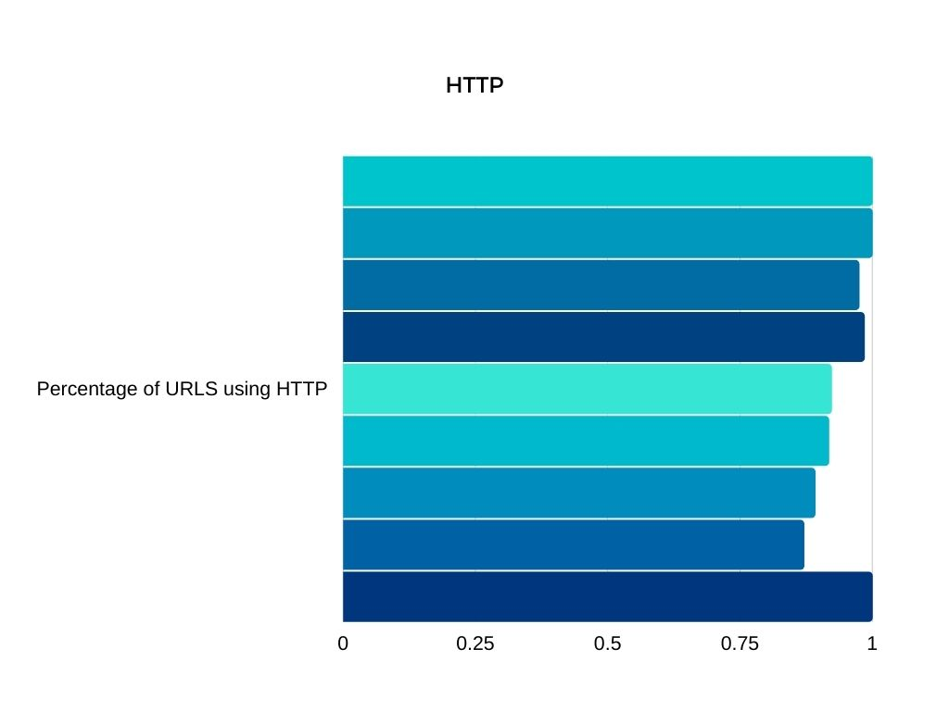
This graph represents the percentage of websites using HTTPS
This clearly shows that most of the websites use HTTPS. By always using HTTPS, web services don’t have to make a subjective judgement call about what’s “sensitive”. This makes development simpler and more consistent. One of the main reasons URLs use HTTPS is because the protocol encrypts communications so attackers can’t steal data.

Slide 3
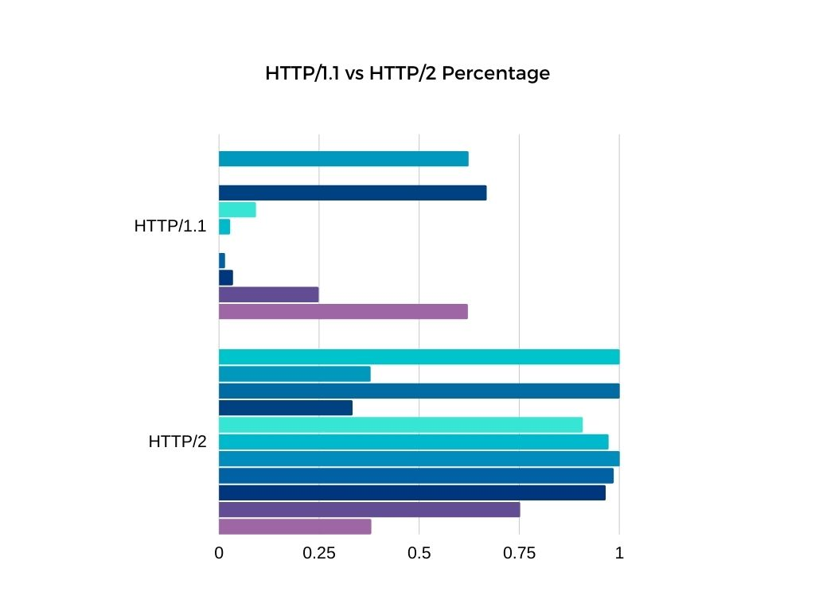
This graph represents the percentage of websites using HTTP/1.1 vs HTTP/2
By looking at this graph you can clearly see that websites prefer using HTTP/2 over HTTP/1.1. If you equate the load time in the next slide you would see that HTTP/2 has a much faster load time. HTTP/1.1 loads resources one after the other, whereas HTTP/2 uses TCP connection to send multiple streams of data at once. HTTP/2 also uses HPACK that eliminates redundant information in HTTP header packets, Given the volume of HTTP packets involved in loading even a single webpage, those bytes add up quickly.

Slide 4
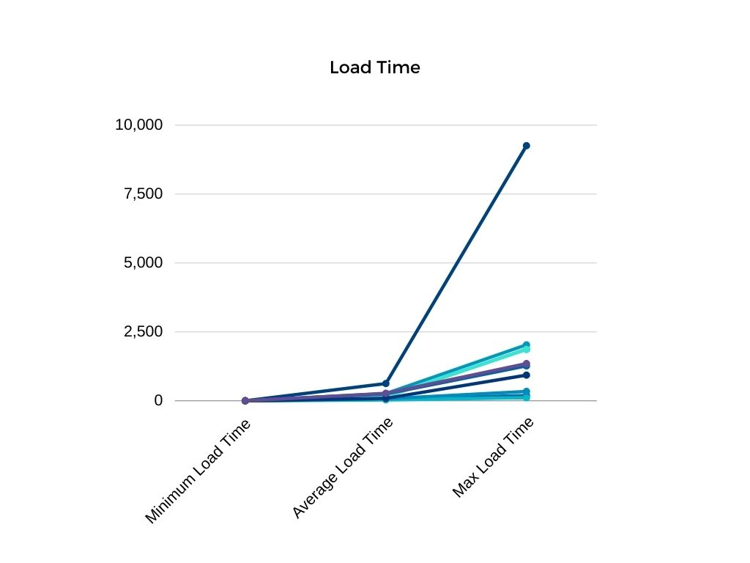
This graph represents the median, mid, and max page load time
Page load time plays a big role in the speed the websites are displayed. A efficient website should take these times into consideration. Speed of site is critical because sites like Google and other search engines will penalize sites that load slowly, but the main issue is users will also. You will lose out on traffic if your site loads slowly. We touch a bit on how HTTP protocol can slow or speed up sites. Looking at different sites it shows that sites that use primary HTTP/1.1 are significantly slower than sites that use HTTP/2. According to google, 53% of mobile users leave a site that takes longer than three seconds to load.

Slide 5
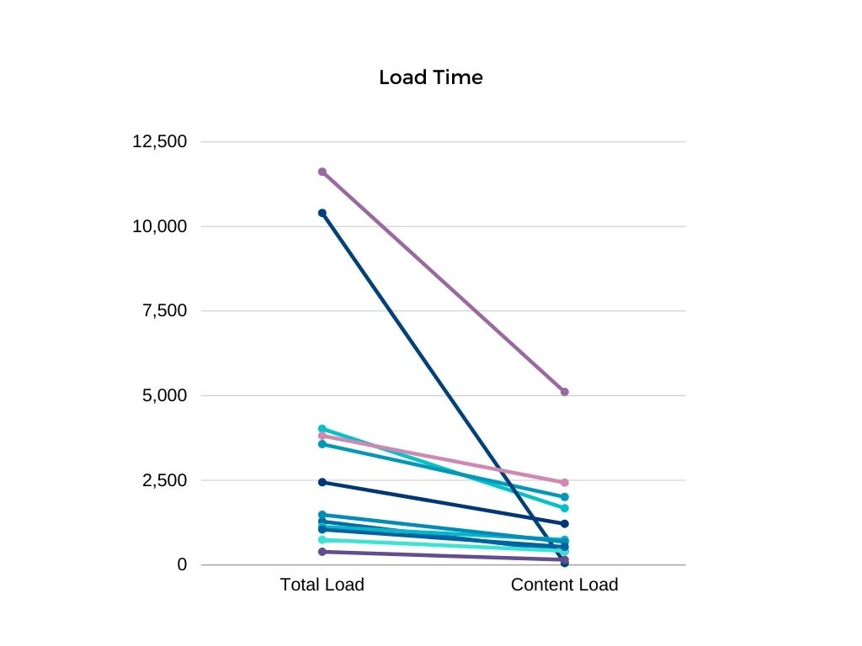
This graph represents the total load time vs content load
This is a Interesting page because it shows that some sites have not much content to load but the total load time of the website is very high. Getting these numbers down are very important for time. Not all websites are created equal.

